Slide 1
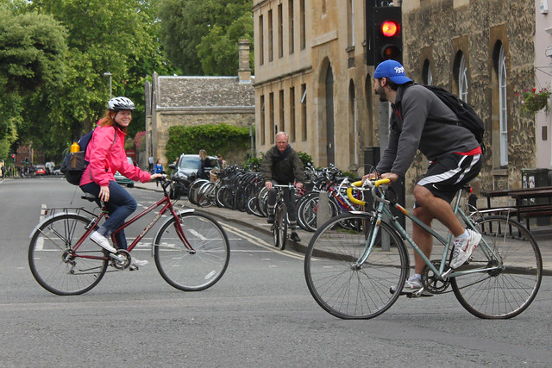

Input image to analyze
Prediction model f
Prediction
$$\hat{y}$$
Examples of different tasks (i.e. types of prediction) in Computer Vision:
Classification
Object detection
Segmentation
Captioning
…
traffic light
person
✓ Street
✘ Office
✘ Bedroom
✘ …
person
person
a girl in a pink jacket on a bicycle passes a man in a blue cap on a bicycle.
car
bike
bike
bike

Slide 2
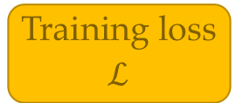
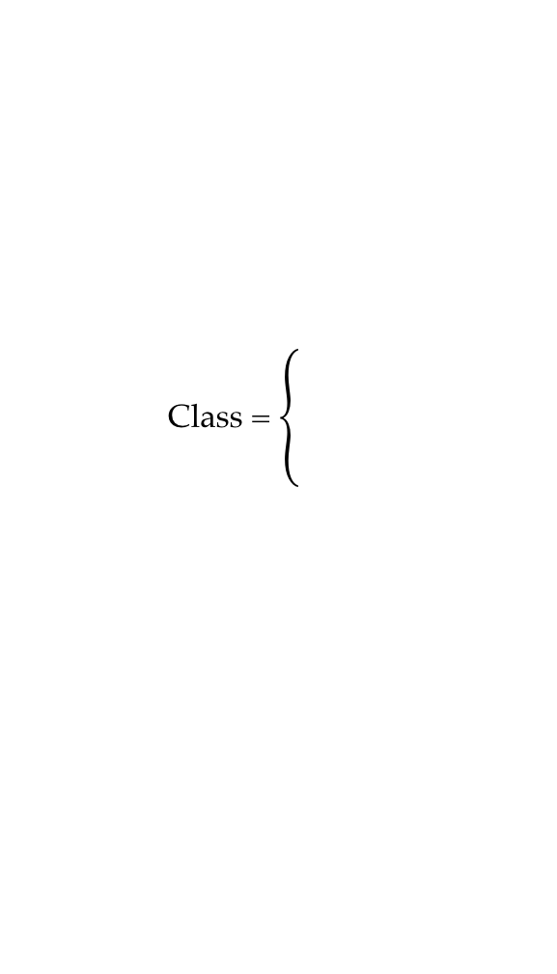
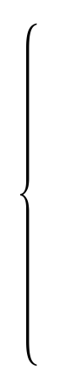

w
Optimization algorithm
Parameters
Prediction model
f
Prediction
Input image x
Training loss
$$ℒ$$
$$\hat{y}$$
Dataset of pairs
(x, y)
Class =
✓ Street
✘ Office
✘ …
Target
y
y

Slide 3
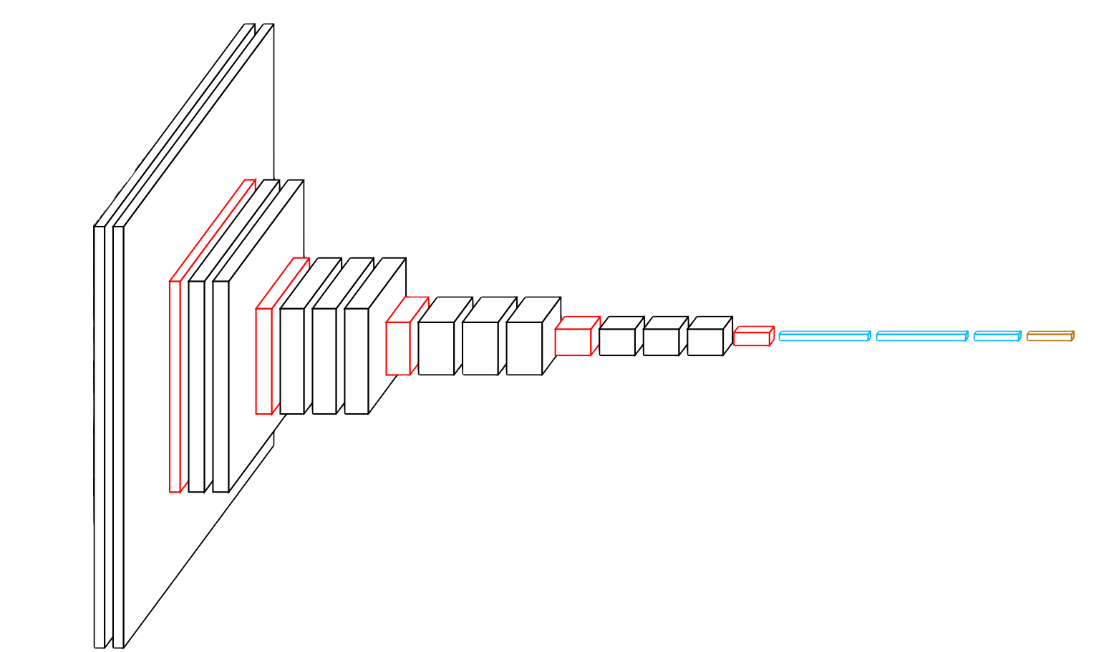
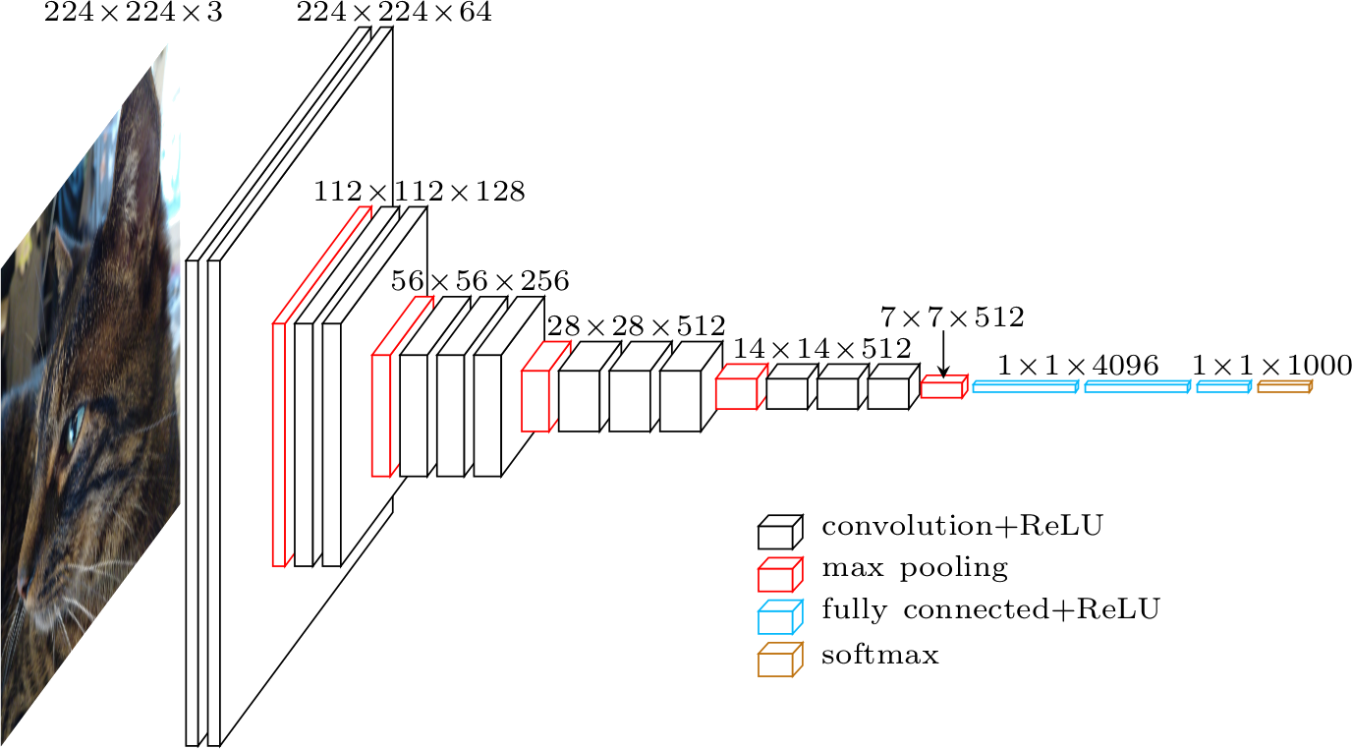

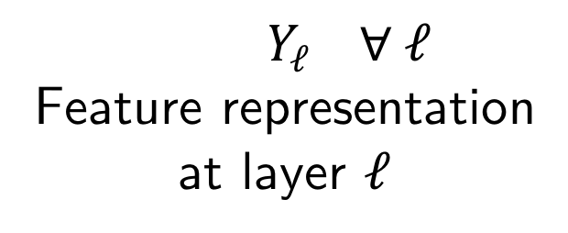
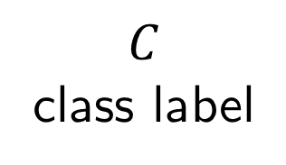
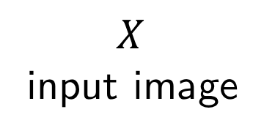
$$X$$ input image
$$Y_{ℓ} ∀ ℓ$$
Feature representation
at layer $ℓ$
$$C$$
class label
cat
$$w$$
Network parameters

Slide 4
LeNet-5
1998
Convolution
MaxPool
AvgPool
Concat
Dropout
Fully connected
Softmax
Residual add
AlexNet
2012
VGG-16
2015
2x
5x
2x
Inception V1
2015
2x
3x
5x
Inception V3
2016
3x
8x
36x
3x
ResNet-152
2016

Slide 5






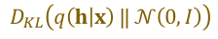

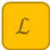
$E$
$D$
$x$
$Θ_{h}$
$h$
$$\hat{x}$$
$$ℒ$$
$ε$
$$D_{KL}\left(q\left(h | x\right) ‖ 𝒩\left(0,I\right)\right)$$

Slide 6
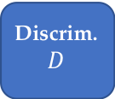

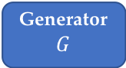

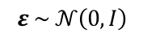

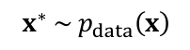

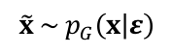
Dataset
$$x^{∗} \sim p_{data}\left(x\right)$$
$$x^{∗}$$
Real
Discrim.
$$D$$
1
or
$$ℒ$$
0
$$ε$$
Generator
$$G$$
$\tilde{x}$
Fake
$$ε \sim 𝒩\left(0,I\right)$$
$$\tilde{x} \sim p_{G}\left(x | ε\right)$$

Slide 7







$ε$
$W$
$V$
$x$
$\tilde{x}$
$z$
$\hat{x}$
Notes:
Auto-encoder

Slide 8





Input
Latent
Reconstr.
$W$
$V$
$x$
$z$
$\hat{x}$
Notes:
Denoising auto-encoder

Slide 9


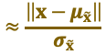







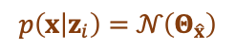
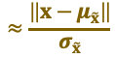



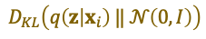

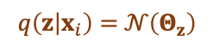



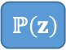



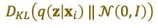

Input
distribution
Latent
distribution
$W$
$ℙ\left(x\right)$
$$ℙ\left(z\right)$$
$Q$
$P$
$$≈\frac{\left\|x−μ_{\tilde{x}}\right\|}{σ_{\tilde{x}}}$$
$x_{i}$
$Θ_{z}$
$z_{i}$
$Θ_{\hat{x}}$
$$ℒ$$
$ε$
$$D_{KL}\left(q\left(z | x_{i}\right) ‖ 𝒩\left(0,I\right)\right)$$
Encoder
Decoder
$$q\left(z | x_{i}\right)=𝒩\left(Θ_{z}\right)$$
$$p\left(x | z_{i}\right)=𝒩\left(Θ_{\hat{x}}\right)$$
$\sim$ reconstruction
$$≈\frac{\left\|x−μ_{\tilde{x}}\right\|}{σ_{\tilde{x}}}$$
$Q$
Sampling
$P$
$x_{i}$
$Θ_{z}$
$z_{i}$
$Θ_{\hat{x}}$
$$ℒ$$
$ε$
$$D_{KL}\left(q\left(z | x_{i}\right) ‖ 𝒩\left(0,I\right)\right)$$
$\sim$ regularization
Notes:
VAE variants

Slide 10











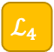

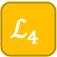

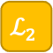


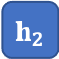








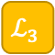
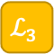

$h_{4}$
${\tilde{h}}_{4}$
${\hat{h}}_{4}$
$$ℒ_{4}$$
$$ℒ_{class}$$
Encoding
Reconstr.
Clean
Noisy
$ε$
$y$
$\tilde{y}$
$\hat{y}$
$$ℒ_{4}$$
$$f$$
$h_{3}$
${\tilde{h}}_{3}$
${\hat{h}}_{3}$
$$ℒ_{3}$$
$ε$
$ε$
$$f$$
$h_{3}$
${\tilde{h}}_{3}$
${\hat{h}}_{3}$
$$ℒ_{3}$$
$$f$$
$h_{2}$
${\tilde{h}}_{2}$
${\hat{h}}_{2}$
$$ℒ_{2}$$
$ε$
$ε$
$$f$$
$h_{2}$
${\tilde{h}}_{2}$
${\hat{h}}_{2}$
$$ℒ_{2}$$
$$f$$
$h_{1}$
${\tilde{h}}_{1}$
${\hat{h}}_{1}$
$$ℒ_{1}$$
$ε$
Notes:
Ladder networks

Slide 11
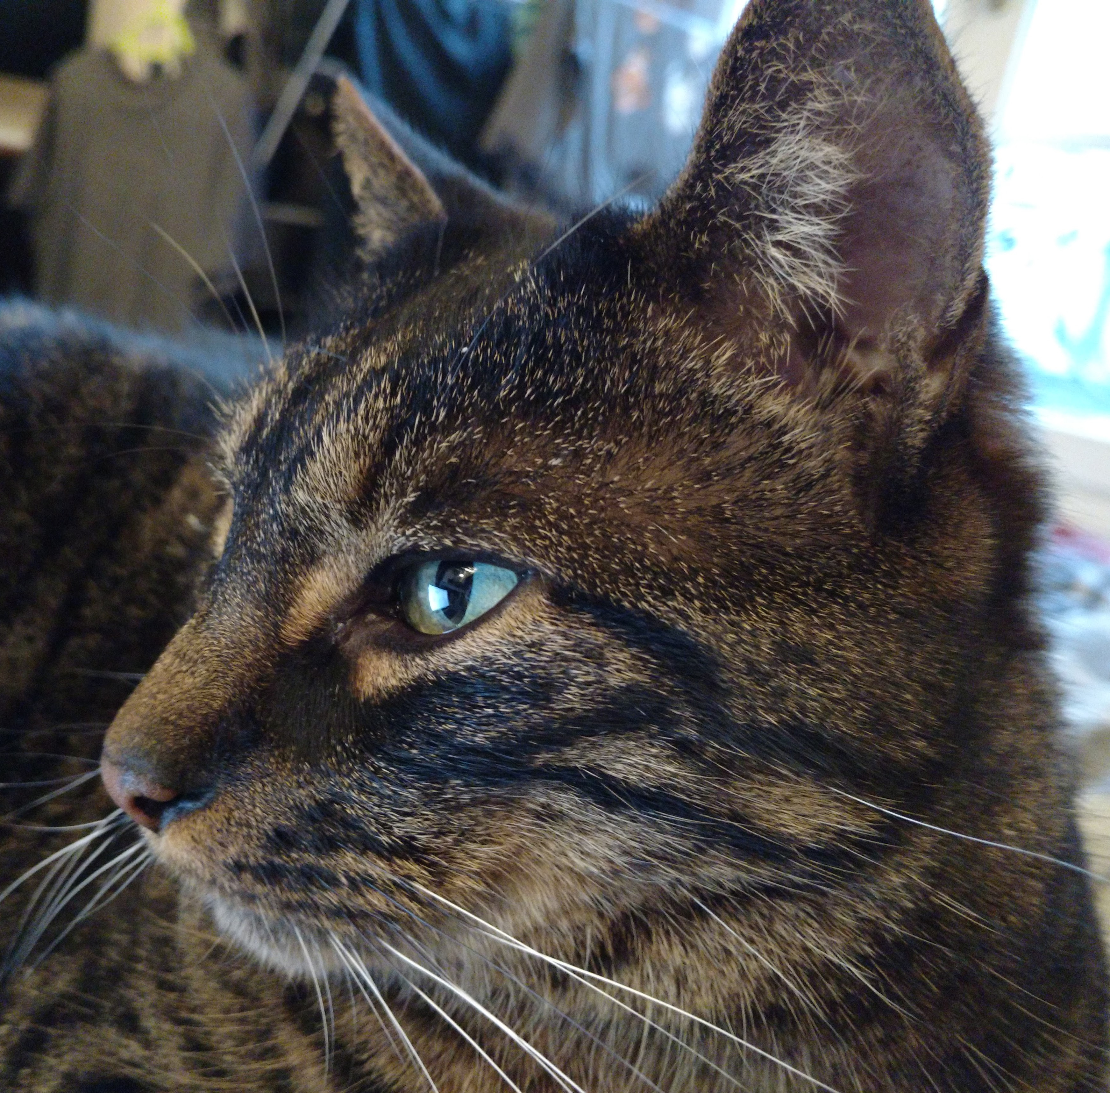
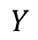
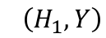
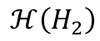
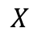
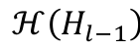
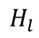
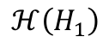
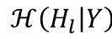
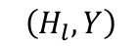
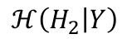
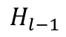
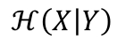

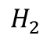
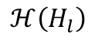
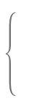
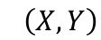

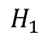
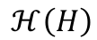
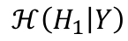
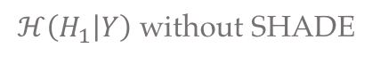
$$X$$
$$H_{1}$$
$$H_{2}$$
$$H_{l−1}$$
$$H_{l}$$
$$Y$$
…
$$ℋ\left(H\right)$$
$$ℋ\left(H_{1}\right)$$
$$ℋ\left(H_{2}\right)$$
…
$$ℋ\left(H_{l−1}\right)$$
$$ℋ\left(H_{l}\right)$$
$$I\left(X,Y\right)$$
$$I\left(H_{1},Y\right)$$
$$I\left(H_{2},Y\right)$$
»
$$I\left(H_{l},Y\right)$$
»
$$ℋ\left(H_{l} | Y\right)$$
$$ℋ\left(X | Y\right)$$
»
$$ℋ\left(H_{1} | Y\right)$$
»
$$ℋ\left(H_{2} | Y\right)$$
$ℋ\left(H_{1} | Y\right)$ without SHADE
»
Effect of SHADE: Reduction of conditional entropy

Slide 12

Input images
Feature representation
E
$$\min{ℋ\left(H\right)}⇒\max{ℋ\left(X | H\right)}$$
increases uncertainty in $X$ given $H$

Slide 13


$$\min{ℋ\left(H | Y\right)}$$
cats
E
cars
$$\min{ℋ\left(H\right)}$$

Slide 14
bird
ŷ
x
W_{c}
x̂
+
W_{u}
HybridNet model

Slide 15












$$C$$
$$\hat{y}$$
$$E_{c}$$
$$D_{c}$$
$$h_{c}$$
$${\hat{x}}_{c}$$
$$x$$
$$\hat{x}$$
$$E_{u}$$
$$D_{u}$$
$$h_{u}$$
$${\hat{x}}_{u}$$

Slide 16












$$C$$
$$\hat{y}$$
$$E_{c}$$
$$D_{c}$$
$$h_{c}$$
$${\hat{x}}_{c}$$
$$x$$
$$\hat{x}$$
$$E_{u}$$
$$D_{u}$$
$$h_{u}$$
$${\hat{x}}_{u}$$

Slide 17








$$C$$
$$\hat{y}$$
$$E_{c}$$
$$h_{c}$$
$$h$$
$$D$$
$$x$$
$$\hat{x}$$
$$E_{u}$$
$$h_{u}$$

Slide 18











$$\text{C}$$
$$\text{y}\text{̂}$$
$ℒ\text{cls}$
E_{c}
D_{c}
$Ω\text{stability}$
h_{c}
$$\text{x}\text{̂}\text{c}$$
$$\text{x}$$
$$\text{x}\text{̂}$$
$ℒ$_{rec}
+ branch + complementarity
-
E_{u}
$$\text{D}\text{u}$$
h_{u}
$$\text{x}\text{̂}\text{u}$$
$ℒ\text{rec}\text{−}\text{inter}$
-

Slide 19
ŷ
x̂_{c}
E_{c}
D_{c}
h_{c}
x
x̂
x̂_{u}
E_{u}
D_{u}
h_{u}
Pooling switches

Slide 20



Input info.
Info. preserved in the encoding
AE
HybridNet
Discriminative
Classif. branch
Unsup. branch
→
Non-discriminative
x
h
h_{c}
h_{u}
Corresponding input data represented

Slide 21
ŷ
Original classifier
x̂_{c}
E_{c}
D_{c}
h_{c}
x
x̂
x̂_{u}
E_{u}
D_{u}
h_{u}
Pooling switches
Convolution
Max Pooling
Upsampling / Unpooling

Slide 22
















Without branch balancing
With branch balancing
$$C$$
$$\hat{y}$$
$$C$$
$$\hat{y}$$
$$E_{c}$$
$$D_{c}$$
$$E_{c}$$
$$D_{c}$$
$$h_{c}$$
$$h_{c}$$
+
+
$$E_{u}$$
$$D_{u}$$
$$E_{u}$$
$$D_{u}$$
$$h_{u}$$
$$h_{u}$$

Slide 23









$Ω_{SHADE}$
Discriminative encoder
Classifier
32×32×64
16×16×64
8×8×64
4×4×64
10
conv
max pool
conv
max pool
conv
max pool
$$h_{c}$$
fc
$$\hat{y}$$
$$ℒ_{cls}$$
Supervised
baseline
32×32×3
5×5
3×3
3×3
$$x$$
32×32×64
16×16×64
8×8×64
4×4×64
4×4×64
8×8×64
16×16×64
32×32×3
32×32×3
conv
max pool
conv
max pool
conv
max pool
$$h_{u}$$
$$h$$
upscale
conv
upscale
conv
upscale
conv
$$\hat{x}$$
$$ℒ_{rec}$$
SWWAE
+
5×5
3×3
3×3
3×3
3×3
5×5
Unsupervised encoder
Decoder

Slide 24





Entangled manifold of input data
Illustrative view of the image manifold
Disentangled representation space
Schematic view of independent factors
Glasses
Makeup
Disentangling model
Hat
Mustache
Smiling
…

Slide 25

Latent representations of
information domains
id 3
Identity h_{y}
id 4
id 1
id 2
Enc.
female
Dec.
$$\hat{x}$$
x
no glasses
glasses
Female, blonde,
smiling…
male
Attributes h_{z}
Female, brown hair,
bangs, smiling…
…
Male, black hair,
not smiling…
Male, black hair,
glasses, beard…
Disentangling
D( , ) =
D( , ) =
D( , ) =
Image editing
D( , ) =
D( , ) =
D( , ) =
D( , ) =
D( , ) =
D( , ) =

Slide 26















Baselines
Architecture
Training
HybridNet
UAI
MTAN
Multi-task
Adv. on y
Ours
Adv. classifiers
Main loss
Discr. loss
Identity branch
C_{z}
$${\hat{z}}_{adv}$$
$$ℒ_{adv,z}$$
E_{y}
h_{y}
W_{y}
$$\hat{y}$$
$$ℒ_{disc,z}$$
U
$$ℒ_{y}$$
U
x
E
h
D
$$\hat{x}$$
$$ℒ_{rec}$$
Attributes branch
$$ℒ_{z}$$
E_{z}
h_{z}
W_{z}
$$\hat{z}$$
$$ℒ_{disc,y}$$
C_{y}
$${\hat{y}}_{adv}$$
$$ℒ_{adv,y}$$
U
U
Loss propagated to
Active
E…
C
Active in UAI variant (C_{y/z} replaced by U_{y/z})
U

Slide 27


















HybridNet-like
No z labels
UAI predictor of opposite latent space
Adv. classifiers / predictor
Enc./dec. loss
Discr. loss
MTAN
Ours
UAI
U_{z}
$\hat{h}$_{z}
$$ℒ_{UAI,adv,z}$$
$$ℒ_{UAI,disc,z}$$
C_{z}
$${\hat{z}}_{adv}$$
$$ℒ_{adv,z}$$
Identity
branch
E_{y}
h_{y}
W_{y}
$$\hat{y}$$
$$ℒ_{disc,z}$$
$$ℒ_{y}$$
x
E
z
h
D
$$\hat{x}$$
$$ℒ_{rec}$$
OR
Attr.
branch
$$ℒ_{z}$$
E_{z}
h_{z}
W_{z}
$$\hat{z}$$
$$ℒ_{disc,y}$$
C_{y}
$${\hat{y}}_{adv}$$
$$ℒ_{adv,y}$$
U_{y}
$\hat{h}$_{z}
$$ℒ_{UAI,disc,y}$$
Optional replacement of h_{z} by z as input of D
Optional gradient blocking
for models without z labels
$$ℒ_{UAI,adv,y}$$
Used as part of the model
Trained to obtain metric (accuracy or disentangling) has no impact on the model
For “HybridNet-like + attr” and “UAI + attr”, simply remove the gradient blocking before W_{z}

Slide 28

id 3
id 4
Identity h_{y}
id 1
id 2
Decoder
Encoder
female
$$\hat{x}$$
x
no glasses
glasses
Female, blonde,
smiling…
male
Attributes h_{z}
Female, brown hair,
bangs, smiling…
Male, black hair,
not smiling…
…
Male, black hair,
glasses, beard…

